Slide 1
In the beginning: The case for belief in a creator
The Reclamation Project
Bible Study
By M. Smith

Slide 2
Agenda
INTRODUCTION
GROUP INTRODUCTIONS
PRIMARY GOAL
GENESIS – CHAPTER 1
MAN IS CREATED IN GOD’S IMAGE AND WHY IT MATTERS
Mere Christianity: the law of human nature
Evidence of Divine design
CONCLUSION
REFERENCES

Slide 3
introductions
About the Author/Leader
M. Smith wrote this Bible Study presentation as part of The Reclamation Project, which seeks to re-establish the sacred traditions and practices of the classical Christian church and reaffirm its culture, values, history, and identity.
Smith has a B.A. in Communications, with an emphasis in Social Science from U.S.C. and an M.S. in Corporate and Organizational Communication with a concentration in Project Management from Northeastern.
She is also a Southern Baptist, a Christian activist, a former online missionary, and a political campaign volunteer who studied Christian apologetics for over 15 years.
Smith's current missionary activities include serving as a remote volunteer project manager/consultant for a Christian philanthropic organization called Genesis Children's Centre – Uganda, located in East-Central Africa.

Slide 4
Group introductions
State your name.
What is your occupation?
What is your role in the church/ministry (if relevant)?

Slide 5
Primary goals
This Bible Study aims to provide an apologetics-based approach to educate and equip the saints to fulfill the Great Commission in the spirit of love and fellowship.

Slide 6
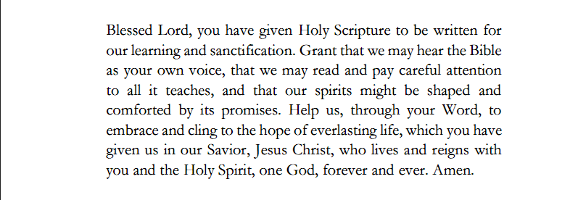
Opening prayer
(Morrow & Stone, 2021, p. 118)

Slide 7
Genesis – chapter 1
The opening of Chapter One is as follows:
The Beginning
1 In the beginning God created the heavens and the earth. ² Now the earth was formless and empty, darkness was over the surface of the deep, and the Spirit of God was hovering over the waters.
³ And God said, “Let there be light,” and there was light. ⁴ God saw that the light was good, and he separated the light from the darkness. ⁵ God called the light “day,” and the darkness he called “night.” And there was evening, and there was morning—the first day. (Holy Bible, New International Version, 2011)

Slide 8
Genesis – chapter 1 cont.
Chapter One – Order of Creation
The heavens and the earth
The separation of light from darkness
Dry land and seas
Vegetation (plants and trees)—bearing seeds according to its kind
(Holy Bible, New International Version, 2011)

Slide 9
Genesis – chapter 1 cont.
Chapter One – Order of Creation
Lights in the sky to separate day and night, mark sacred times, days, and years
The creation of sea creatures, birds, and land animals
Mankind in His own image and likeness to rule the creatures of the earth:
²⁷ So God created mankind in his own image,
in the image of God he created them;
male and female he created them.
(Holy Bible, New International Version, 2011)

Slide 10
man is Created in god’s image and why it matters
Being created in God’s image and likeness means that man has been endowed with a soul
What is the soul?
In the book Surprised by Suffering, notable preacher Dr. R.C. Sproul (2009) discusses how Plato sought to prove that we were born with certain ideas that point to the preexistence of a soul. “Our ideas of beauty, goodness, justice, and holiness, for example, are not acquired from experience in this life but are already present at birth (Loc. 836)”

Slide 11
man is Created in god’s image and why it matters, CONT.
Sproul (2009) further writes that Socrates “argues that the soul is a spiritual essence. He notes that as a spiritual essence, the soul is not made of matter, which is capable of decay or dissolution. Thus, it cannot die (Loc. 845)”
Further, while Socrates argues that the soul is unchangeable, he simultaneously declares that it is capable of moral corruption (Loc. 849)
This definition of the soul distinguishes man from animal. Animals have a spirit, but they do not have a soul

Slide 12
man is Created in god’s image and why it matters, CONT.
If we are indeed born with ideas of “beauty, goodness, justice, and holiness,” as Plato suggested, then how did that happen?
Humans also are far away above every creature on earth in terms of intellect, as we can mold and shape the reality around us
Every culture on earth has a sense of some religion or recognition of the transcendent. So why would humans “evolve” to have this trait if there is no God?
If you designed an android in your image as a human, then it stands to reason that you would create a robot with human-like traits

Slide 13
Mere Christianity: the law of human nature
Clive Stapleton Lewis (1898-1963), aka C.S. Lewis, is considered one of the greatest Christian apologists of the 20th century (‌Lewis,1952/2001)
He was an Oxford graduate and former atheist who was converted to Christianity by J.R.R. Tolkien of The Lord of the Rings fame, who was a devout Catholic
Lewis subsequently wrote The Chronicles of Narnia and highly acclaimed Christian apologetics works like Mere Christianity, The Abolition of Man, and so forth
In the first Chapter of Mere Christianity, Lewis makes a case for a Creator by pointing out that the Law of Nature, which used to be called Right and Wrong, gives clues to the meaning of the universe
Notes:
Mere Christianity will be explored in greater depths in future presentations.

Slide 14
Evidence of Divine design
One of the most significant cases for a Creator is creation itself, especially mankind
In the book of Romans, the Apostle Paul wrote: “For since the creation of the world God’s invisible qualities—his eternal power and divine nature—have been clearly seen, being understood from what has been made, so that people are without excuse.” (Holy Bible, New International Version, 2011)
The universe has laws, and humans also have both moral and legal laws. Laws must have a lawgiver (‌Lewis, 1952/2001; Geisler & Turek, 2004)

Slide 15
Evidence of Divine design cont.
What is the probability that the universe came about by chance?
“Oxford University Professor of Mathematics John Lennox quotes renowned Oxford University mathematical physicist Roger Penrose: …the ‘Creator’s aim’ must have been accurate to 1 part in 10 to the power of 10 to the power or 123, that is 1 followed by 10 to the 123rd power zeros.” (Youngren, 2020)
What are the odds of you being born? “In a 2011 Tedx Talk, self-help author Mel Robbins announced that the odds of being born are one in 400 trillion”(Bowe, 2019)

Slide 16
conclusion
If there is a God, then life has meaning and purpose
If there is no God, then not only is the opposite of the above true, there is no such thing as right and wrong
It is our duty as humans to seek out and understand God’s divine law to live according to His purpose, advance spiritually, and protect our souls from moral corruption
Give thanks for a good God during this Thanksgiving season as you are part of his divine creation
What are you thankful for this holiday?

Slide 17
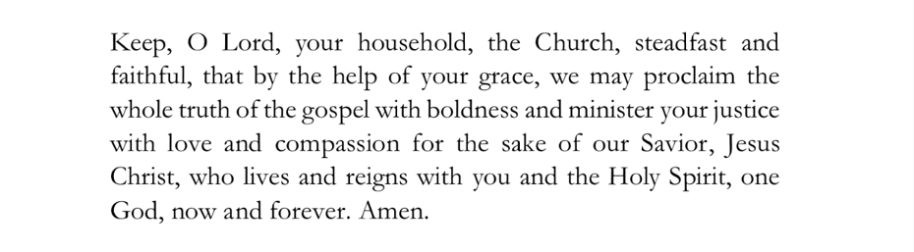
Closing prayer
(Morrow & Stone, 2021, p. 112)

Slide 18
Thank you
M. Smith​
info@thereclamationproject.net‬‬

Slide 19
REFERENCES
Bowe, K. (2019, June 5). Your odds of being alive. Medium. https://medium.com/afwp/your-odds-of-being-alive-af7826915073
Holy Bible, New International Version. (2011). Bible Gateway. https://www.biblegateway.com/ (Original work published 1973)
Geisler, N. L., & Turek, F. (2004). I don’t have enough faith to be an atheist. Crossway.
Lewis, C. S. (1952/2001). Mere Christianity. HarperSanfrancisco. (Original work published 1952).
Morrow, P., & Stone, W. (2021). Daily prayer for Baptists. Bowker Identifier Services.
‌Sproul, R. C. (2009). Surprised by suffering. Reformation Trust.
Youngren, S. (2020, October 1). Your odds of being alive. God Evidence. Retrieved November 21, 2022, from https://godevidence.com/author/god-evidence/
Notes:
APA 7th Edition

