Slide 1
Defending the Integrity of the Bible
The Reclamation Project
Bible Study
The Translations and How It Came Together
By M. Smith
Notes:
APA Style format, Seventh Edition

Slide 2


Agenda
A
I. Introductions
II. Primary Goals
III. Where Does Our Bible Come From?
IV. Four Fundamental Challenges to the Bible
V. Q&A Discussion
VII. Closing Prayer

Slide 3
Introductions
About the Author/Leader
M. Smith wrote this Bible Study presentation as part of The Reclamation Project, which seeks to re-establish the sacred traditions and practices of the classical Christian church and reaffirm its culture, values, history, and identity.
Smith has a B.A. in Communications, with an emphasis in Social Science from U.S.C. and an M.S. in Corporate and Organizational Communication with a concentration in Project Management from Northeastern.
She is also a Southern Baptist, a Christian activist, a former online missionary, and a political campaign volunteer who studied Christian apologetics for over 15 years.
Smith's current missionary activities include serving as a remote volunteer project manager/consultant for a Christian philanthropic organization called Genesis Children's Centre – Uganda, located in East-Central Africa.

Slide 4
Group Introductions
State your name.
What is your occupation?
What is your role in the church/ministry (if relevant)?

Slide 5
Primary Goals
This Bible Study aims to provide an apologetics-based approach to educate and equip the saints to fulfill the Great Commission in the spirit of love and fellowship.
Notes:
What are your goals in joining this group and attending this session?

Slide 6
Opening Prayer
Dear God,
Thank you for giving us your word. Help us to open our hearts and minds to learn from you. Guide us in our studies, and give us wisdom and understanding.
Amen (Prayrs.org, 2020)

Slide 7
According to Britannica, in Christianity, apologetics is the intellectual defense of the truth of the Christian religion, usually considered a branch of theology.
“
What is Apologetics?
”
Its function is both to fortify the believer against personal doubts and to remove the intellectual stumbling blocks that inhibit the conversion of unbelievers. (Apologetics | Christianity, n.d.)
Notes:
Source: https://www.britannica.com/topic/apologetics (11/06/22).

Slide 8
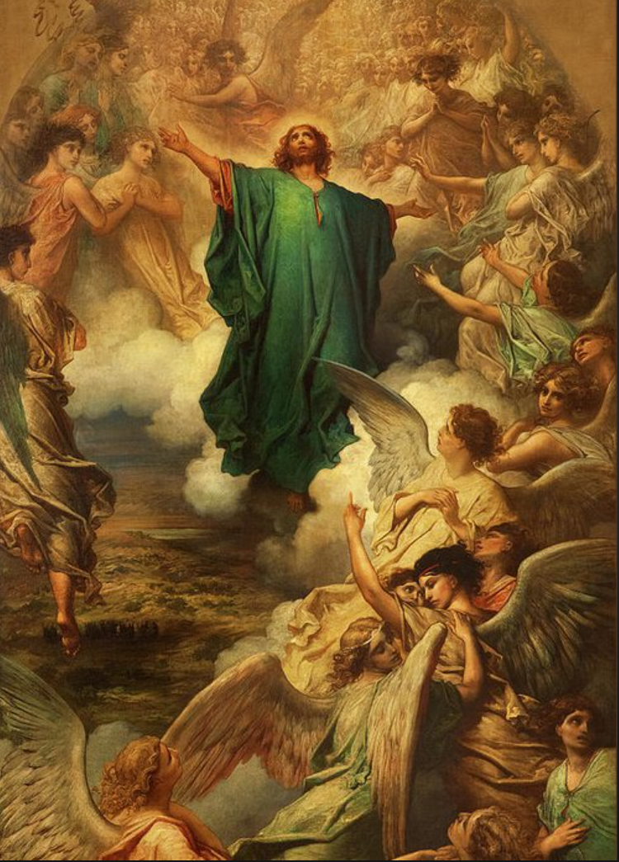
What Does the Bible Say?
What is the Great Commission?
According to Matthew 28: 16 (NIV):
16 Then the eleven disciples went to Galilee, to the mountain where Jesus had told them to go. 17 When they saw him, they worshiped him; but some doubted. 18 Then Jesus came to them and said, “All authority in heaven and on earth has been given to me. 19 Therefore go and make disciples of all nations, baptizing them in the name of the Father and of the Son and of the Holy Spirit, 20 and teaching them to obey everything I have commanded you. And surely I am with you always, to the very end of the age.” (Holy Bible, New International Version, 2011)
Gustave, D. (n.d.). The Ascension of Christ greeting card. [Painting]. Fine Art America. https://fineartamerica.com/featured/the-ascension-of-christ-gustave-dore.html?product=greeting-card
Notes:
https://biblereasons.com/defending-the-faith/

Slide 9
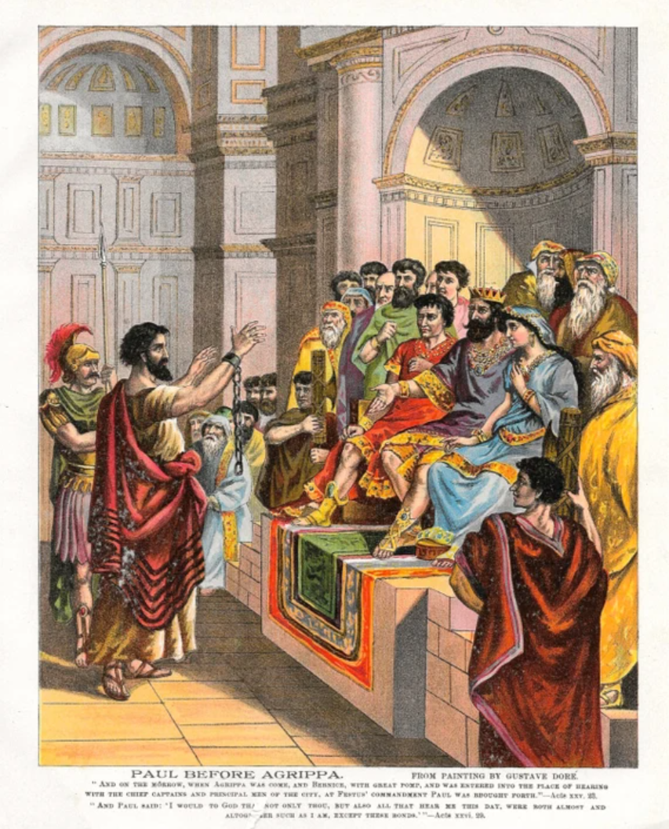
What Does the Bible Say?
Apologetics-Related Scriptures
Jude 1:3 Dear friends, although I was very eager to write to you about the salvation we share, I felt compelled to write and urge you to contend for the faith that was once for all entrusted to God’s holy people.
1 Peter 3:15 but honor the Messiah as Lord in your hearts. Always be ready to give a defense to anyone who asks you for a reason for the hope that is in you.
2 Corinthians 10:5 We destroy arguments and every lofty opinion raised against the knowledge of God, and take every thought captive to obey Christ
Psalm 94:16 Who will rise up for me against the wicked? Who will take a stand for me against evildoers?
Gustave, D. (n.d.). Antique Bible print Paul before Agrippa. [Illustration]. Etsy.com. https://img.etsystatic.com/il/9d557b/762015805/il_570xN.762015805_jxpr.jpg?version=0

Slide 10
What Does the Bible Say?
Apologetics-Related Scriptures cont.
Titus 1:9 He must be devoted to the trustworthy message we teach. Then he can use these accurate teachings to encourage people and correct those who oppose the word.
Timothy 4:2 Preach the word; be prepared in season and out of season; correct, rebuke and encourage–with great patience and careful instruction.
Philippians 1:16 The latter do so out of love, knowing that I am put here for the defense of the gospel.
Ephesians 5:11 Take no part in the unfruitful works of darkness, but instead expose them.
(Chery, 2022)
Gustave, D. (n.d.). Antique Bible print Paul before Agrippa. [Illustration]. Etsy.com. https://img.etsystatic.com/il/9d557b/762015805/il_570xN.762015805_jxpr.jpg?version=0
Notes:
Sources: Versus used: (https://biblereasons.com/defending-the-faith/) for Peter 3:15 onward;
The Ascension of Christ Greeting Card by Gustave Dore (https://images.search.yahoo.com/search/images;_ylt=Awr9_obROGhjsbwcZ5NXNyoA;_ylu=Y29sbwNncTEEcG9zAzEEdnRpZAMEc2VjA3BpdnM-?p=gustave+dore+jesus+great+commission&fr2=piv-web&type=sbc_dsl/E211US105G0&fr=mcafee#id=14&iurl=https%3A%2F%2Frender.fineartamerica.com%2Fimages%2Frendered%2Fdefault%2Fgreeting-card%2Fimages%2Fartworkimages%2Fmedium%2F3%2Fthe-ascension-of-christ-gustave-dore.jpg%3F%26targetx%3D0%26targety%3D-45%26imagewidth%3D500%26imageheight%3D791%26modelwidth%3D500%26modelheight%3D700%26backgroundcolor%3D4E3116%26orientation%3D1&action=click)
https://biblereasons.com/defending-the-faith/

Slide 11
Where Does Our Bible Come From?
W
The Old Testament Formation
According to Ryan Leasure (2021) of Cross Examined.org, the Old Testament that we use today, containing 39 books, was written by dozens of authors over a thousand years.
God gave Moses the very first Scriptural text, as described in Exodus 31:18, in the form of the Ten Commandments.
Moses subsequently compiled it and other works into the Pentateuch (the first five books of the Bible).
Clans of scribes during the Old Testament era took great care to copy and preserve the Hebrew Bible.

Slide 12
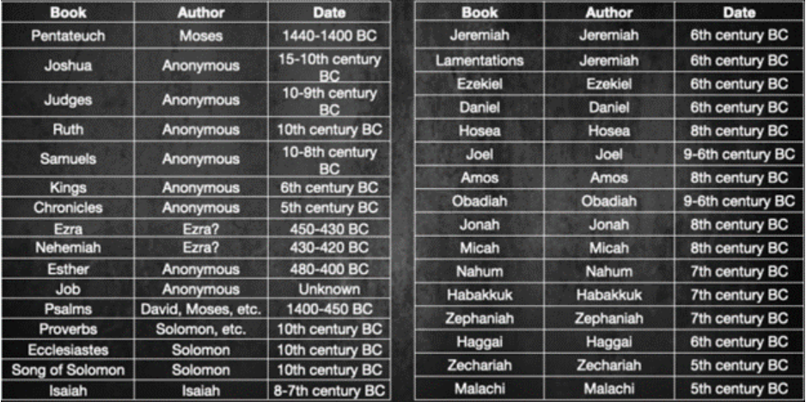
Old Testament Authors and Dates
OT
Leasure, R. (2021). Authors and dates. [Photograph]. Cross Examined.org. https://crossexamined.org/how-we-got-our-bible-old-testament-formation
Note that the dates are approximations.
The discovery of the Dead Sea Scrolls in 1947 contains documents dating back from 50 BC to AD 65 and presents compelling evidence of the accuracy of our current Bible (Leasure, 2021).
These documents include every book of the Old Testament except for Esther.

Slide 13
Where Does Our Bible Come From?
NT
The New Testament Formation
The New Testament contains 27 books. Together with the Old Testament, the Bible is comprised of 66 books.
The canon was written over a shorter period than the Old Testament, before 95 A.D (Kennedy & Newcombe, 2006).
Most of the works of the New Testament were accepted before 200 A.D, and all were fully recognized by the Council of Hippo in 393. See table 14.2 in the upcoming slide (Geisler & Turek, 2004).
All were written in the first century by eyewitnesses or those who interviewed them (Geisler & Turek, 2004).

Slide 14
Four Fundamental Challenges to the Bible
The Bible Has Been Changed or Mistranslated Over the Centuries
Books Have been Added and Taken Out
The Bible is not Historically Accurate
How Do You Know it is Divinely Inspired?

Slide 15
I. The Bible Has Been Changed or Mistranslated Over the Centuries
This assertion demonstrates a fundamental misunderstanding of the history of the Bible. And most people only make this statement based upon what they have heard from others and not due to any true scholarship on the matter.
According to Greg Koukl (2003) of Stand To Reason, there is a branch of study called “Textual Transmission, Lower Criticism of the Bible.” The science studies the evidence of a given work to recover the original text, in this case, the Bible (Track 7, 2:26).
The fact is that the current translations go directly from ancient Greek to English, with no steps in between that process (Koukl, 2002).
There are over 24,000 ancient fragments of the New Testament, which far exceeds any ancient text from Homer, Plato, Herodotus, and so forth (Wallace, 2016; Geisler & Turek, 2004).
Notes:
https://coldcasechristianity.com/writings/when-it-comes-to-ancient-texts-the-more-copies-we-have-the-more-confidence-we-have/J. Warner Wallace (July 1, 2016)
Geisler & Turek (2004) – I Don’t Have Enough Faith to Be an Atheist (book)
Greg Koukl (2002) ABC –Has God Spoken (Koukl, p. )

Slide 16
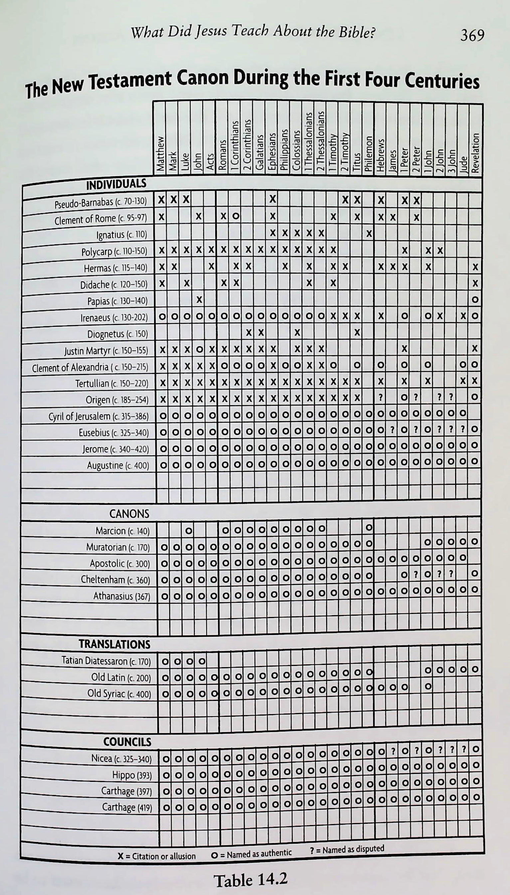
II. Books Have been Added and Taken Out
Just as The Dead Sea Scrolls support the integrity of the Old Testament that we presently use, we have similarly compelling evidence that The New Testament is a reliable reflection of the original books.
NT
(Geisler & Turek, 2004). I don’t have enough faith to be an atheist. [Photograph] Crossway.

Slide 17
III. The Bible is not Historically Accurate
If the Bible is true, then not only should the history be accurate, there ought to be physical evidence that objectively corroborates it.
The Bible is the only book that can point to historical occurrences to support its theological claims.
The New Testament writers included over 30 confirmed individuals in their texts (i.e., Pilate, the entire Herodian bloodline, and so forth) (Geisler &Turek, 2004).
Authored in 2017, Etched in Stone provides over 70 archeological discoveries that attest to the Christian faith's accuracy (Bassett-Brody, 2017).
Notes:
Greg Koukl (2002) ABC –Has God Spoken (Koukl, p. 9 )
Geisler & Turek (2004) – I Don’t Have Enough Faith to Be an Atheist (book)
Lisette Bassett-Brody, Etched in Stone, 2017

Slide 18
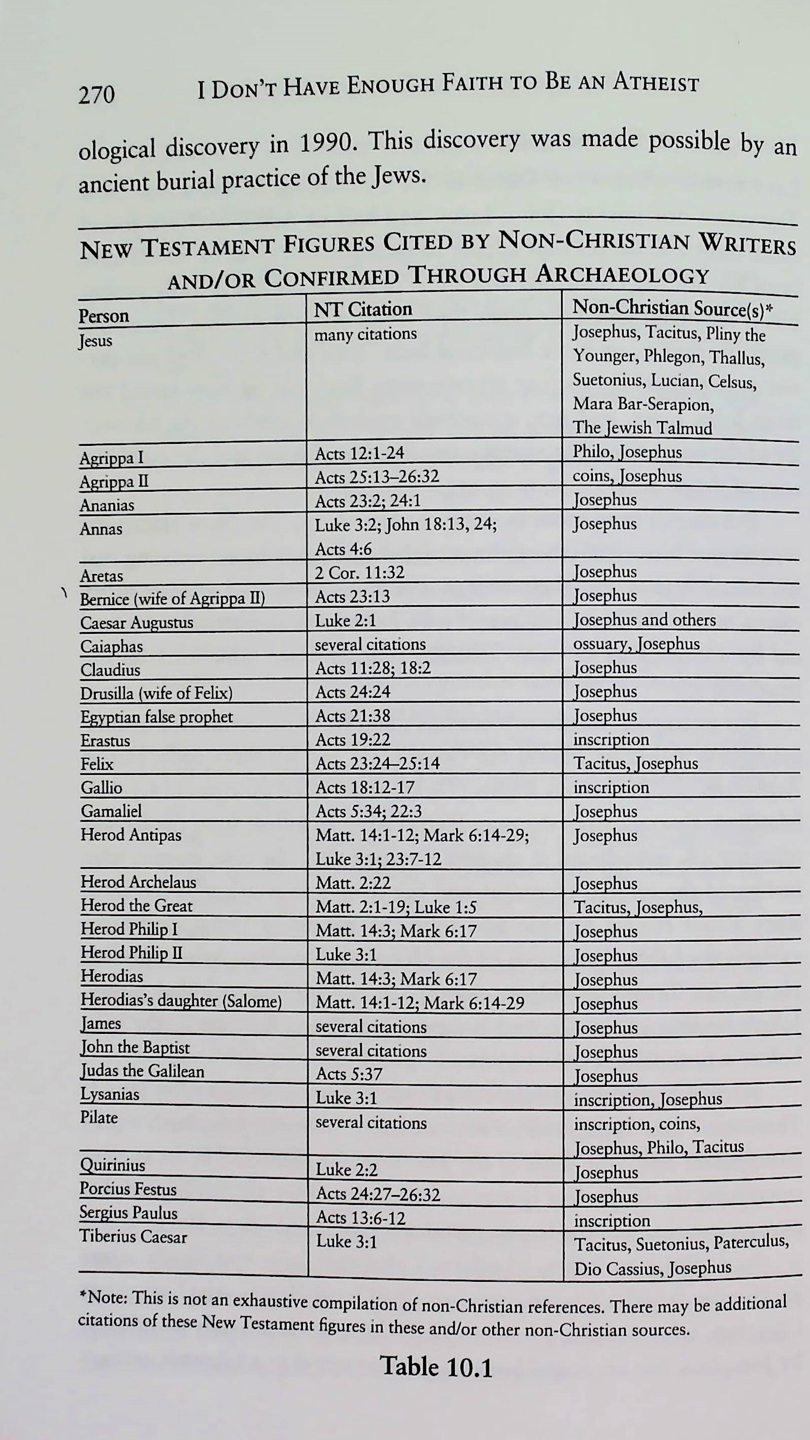
New Testament Figures Cited by Non-Christian Writers and/or Confirmed Through Archeology
NT
Geisler & Turek, 2004). I don’t have enough faith to be an atheist. [Photograph] Crossway.
Notes:
Source: Geisler & Turek (2004) – I Don’t Have Enough Faith to Be an Atheist (book), pg 270

Slide 19
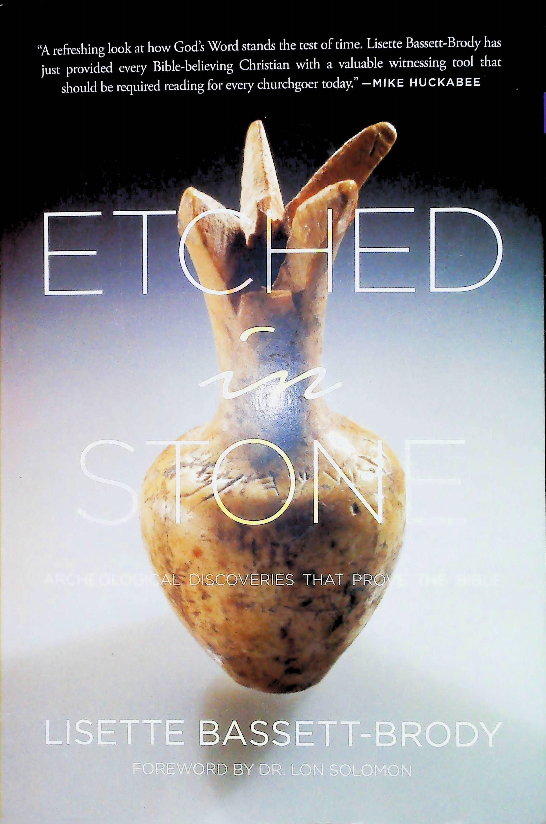
ETCHED IN STONE
NT
Bassett-Brody, L. (2017). Etched in stone: archeological discoveries that prove the Bible. [Photograph]. WND Books.
Notes:
Source: Lisette Bassett-Brody, Etched in Stone, 2017

Slide 20
IV. How Do You Know it is Divinely Inspired?
“The Bible has the stamp of the supernatural … Supernatural predictions, supernatural unity, supernatural insight, records supernatural events, has supernatural impact, and has shown supernatural endurance and survival” (Koukl, 2002, p. 10).”
The Bible is the only volume ever produced by man in which detailed prophecies about the rise and fall of individuals and empires are given with hairsplitting accuracy (Koukl, 2002, p. 7).
Notes:
Source: Greg Koukl (2002) ABC –Has God Spoken (Koukl, p. 9 )
Geisler & Turek (2004) – I Don’t Have Enough Faith to Be an Atheist (book)
Lisette Bassett-Brody, Etched in Stone, 2017

Slide 21
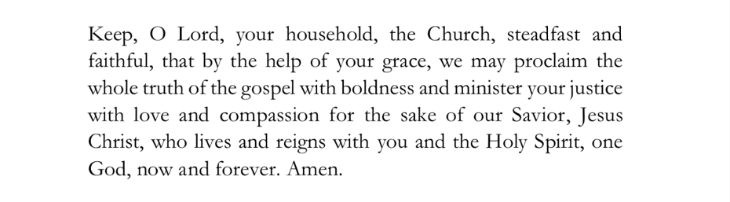
Closing Prayer
(Morrow & Stone, 2021, p. 112)
Notes:
Source: Daily Prayer for Baptists Patrick Marrow and David Stone (2021) 1st Ed, p. 112

Slide 22
Thank you
M. Smith​
info@thereclamationproject.net‬‬

Slide 23
References
Apologetics | Christianity. (n.d.). Encyclopedia Britannica. https://www.britannica.com/topic/apologetics
Chery, F. (2022, November 12). 15 important Bible verses about defending the faith. Bible Reasons. https://biblereasons.com/defending-the-faith/
Geisler, N. L., & Turek, F. (2004). I don’t have enough faith to be an atheist. Crossway.
Holy Bible, New International Version. (2011). Bible Gateway. https://www.biblegateway.com/ (Original work published 1973)
Kennedy, J. & Newcombe, J. (2006). The Da Vinci myth versus the gospel truth. Crossway.
Koukl, G. (2002). Course one of three: Ambassador basic curriculum. The Bible: has God spoken. [pdf study notes on Audiobook]. Stand to Reason.
Koukl, G. (2003). Course one of three: Ambassador basic curriculum. The Bible: has God spoken. [Audiobook]. Stand to Reason.
Koukl, G. (2019). Tactics: a game plan for discussing your Christian convictions. Zondervan Reflective.
Leasure, R. (2021, November 22). How we got our Bible: Old Testament formation. Cross Examined. https://crossexamined.org/how-we-got-our-bible-old-testament-formation/
Notes:
APA Style format, Seventh Edition

Slide 24
References
Prayrs.org. (2020, November 29). 9 Opening prayers for Bible study - Prayrs. Prayrs.org. https://prayrs.org/7-opening-prayers-for-bible-study/
Wallace, J. W. (2016, July 1). When it comes to ancient texts, the more copies we have, the more confidence we have. Cold Case Christianity. https://coldcasechristianity.com/writings/when-it-comes-to-
ancient-texts-the-more-copies-we-have-the-more-confidence-we-have/

